Slide 1
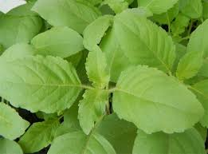
TULSI
07_Rabin Nadar
S.Y B.Sc IT
Anandibai Damodar Kale Degree College

Slide 2
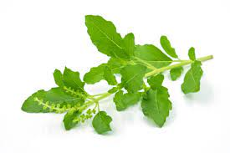
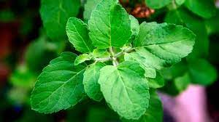
AN overview
The Tulsi plant, also known as Holy Basil, is a sacred herb in Hinduism and is revered in traditional Indian culture for its spiritual and medicinal properties.

Slide 3
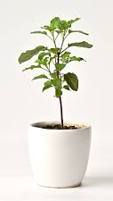
IMPORTANCE of tulsi
Medicinal Properties.
Environmental Benefits.
Mental Well-being.

Slide 4
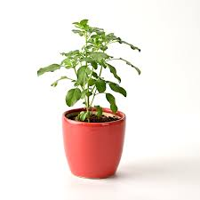
USES OF TULSI IN AYURVEDa
Immune system support.
Respiratory health.
Stress and anxiety relief.
Digestive support.
Skin health.
Oral health.

Slide 5

THANK YOU
07_RABIN NADAR
S.Y B.Sc IT
ANANDIBAI DAMODAR KALE DEGREE COLLEGE

